Slide 1
Music Composition with Deep Learning:
A Review
Carlos Hernandez-Olivan*, Jose R. Beltran
April 2022
*carloshero@unizar.es

Slide 2
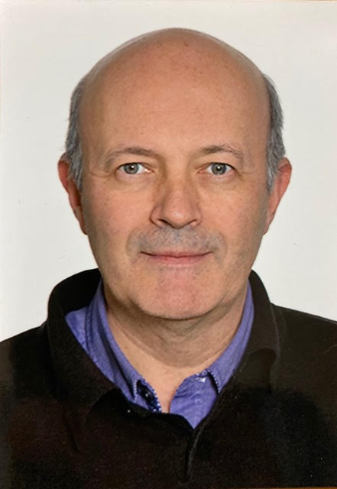
Carlos Hernandez-Olivan
José Ramón Beltrán
Carlos Hernández Oliván is a PhD student in Electronics at the Universidad de Zaragoza under the supervision of Dr. José R. Beltrán. He received the B.E. and M.Sc. degrees in Industrial Engineering in 2017 and 2019, respectively. He studied viola at the Professional Conservatory of Zaragoza where he received his professional certificate in 2013. His research interests are focused on Music Information Retrieval, in particular, on music analysis and generation systems with Artificial Intelligence.
José R. Beltrán is an Associate Professor with the Department of Electronic Engineering and Communications, University of Zaragoza. He has been involved in different research and development projects on Audio Analysis and Processing. His research interests are focused on the study of Automatic Learning Systems for the analysis, processing and synthesis of the musical signal. In 2008, he was a promoter of an academic spin-off: ARSTIC Audiovisual Solutions S.L. devoted to the use of technologies for the artistic and audiovisual fields.
Prof. Beltrán is a member of the Aragon Institute for Engineering Research (I3A), Reseach Group in Advanced Interfaces (AffeciveLab).

Slide 3
Outline
What is Automatic Music Composition?
From Algorithmic Composition to AI-based Music Composition
Music Composition with Deep Learning
AI-based Music Composition Evaluation
New Trends: Human-Computer Interaction, style stransfer…
3 / 33
Carlos Hernandez-Olivan, Jose R. Beltran

Slide 4
Some Open Questions
Are the current DL models capable of generating music with a certain level of creativity?
What is the best NN architecture to perform music composition with DL?
Could end-to-end methods generate entire structured music pieces?
Are the composed pieces with DL just an imitation of the inputs or can NNs generate new music in styles that are not present in the training data?
4 / 33
Carlos Hernandez-Olivan, Jose R. Beltran

Slide 5
A Few more...
Should NNs compose music by following the same logic and process as humans do?
How much data do DL models for music generation need?
Are current evaluation methods good enough to compare and measure the creativity of the composed music?
Are we (researchers, developers…) designing DL models according to the music basic principles, or are we just taking models from other fields to do the music composition task?
5 / 33
Carlos Hernandez-Olivan, Jose R. Beltran

Slide 6
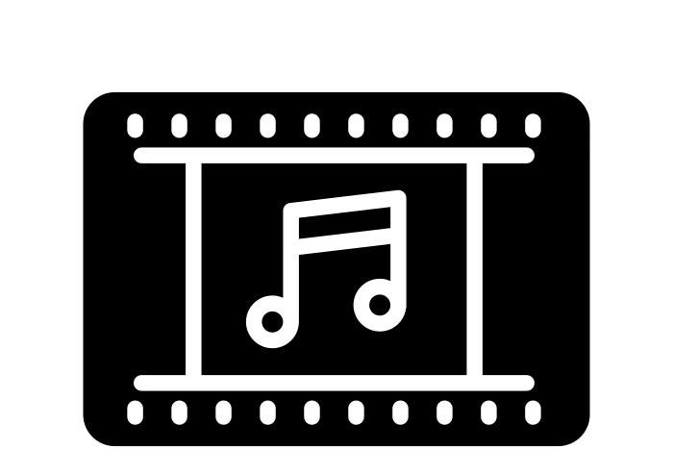
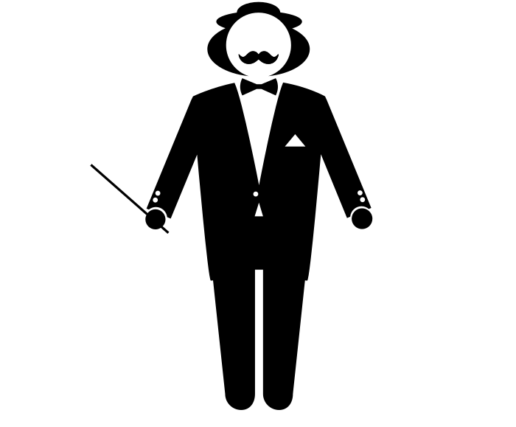
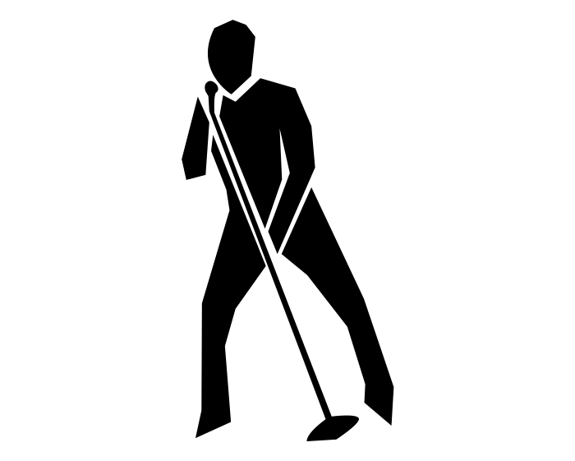
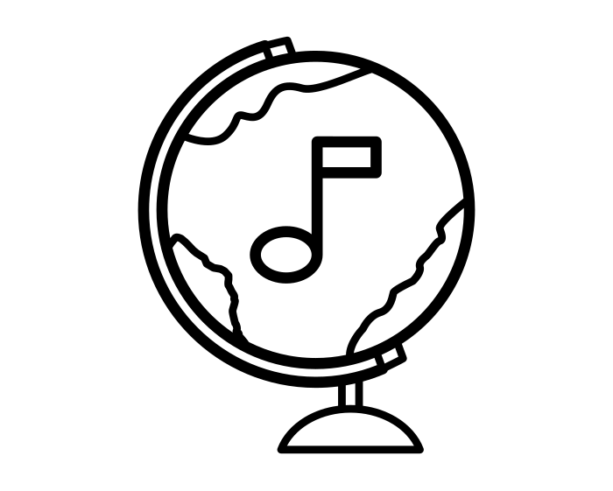
Outline: Music Classification (1880s – 2020s)
“UTILITY” MUSIC
CLASSICAL MUSIC
POPULAR MUSIC / FOLK
Religious
Soundtracks (TV, Cinema…)
…
Genres/Periods
Rock ‘N’ Roll
Pop
Punk
…
Country
Blues
Jazz
Gospel
Rap
Techno
Medieval
Renaissance
Baroque
Classical
Romantic
Modern
Contemporary
MUSIC OF THE WORLD
Habanera
Salsa
…
Forms
Symphony
Chamber
Opera
Vocal
Musicmap | The Genealogy and History of Popular Music Genres
6 / 33
Carlos Hernandez-Olivan, Jose R. Beltran

Slide 7
Outline: Why Music Composition is difficult
Music is subjective
Each music Genre has its own rules
Tonal/atonal…
Music means repetition
Has local and high-level structures
2 axes
Harmony and time are dependent to each other
Passing notes
Appogiated chords
Ornamentations
...
Intricacies
7 / 33
Carlos Hernandez-Olivan, Jose R. Beltran

Slide 8
The “Power” of Motifs: Examples
Composition:
“mystery”
Only piano, high notes, minor chords with altered notes…
Composition + Orchestration + Performance:
“power”
8 / 33
Carlos Hernandez-Olivan, Jose R. Beltran

Slide 9
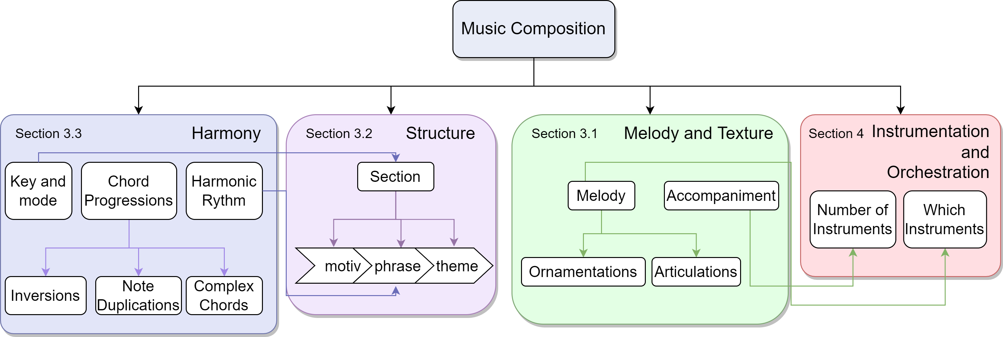
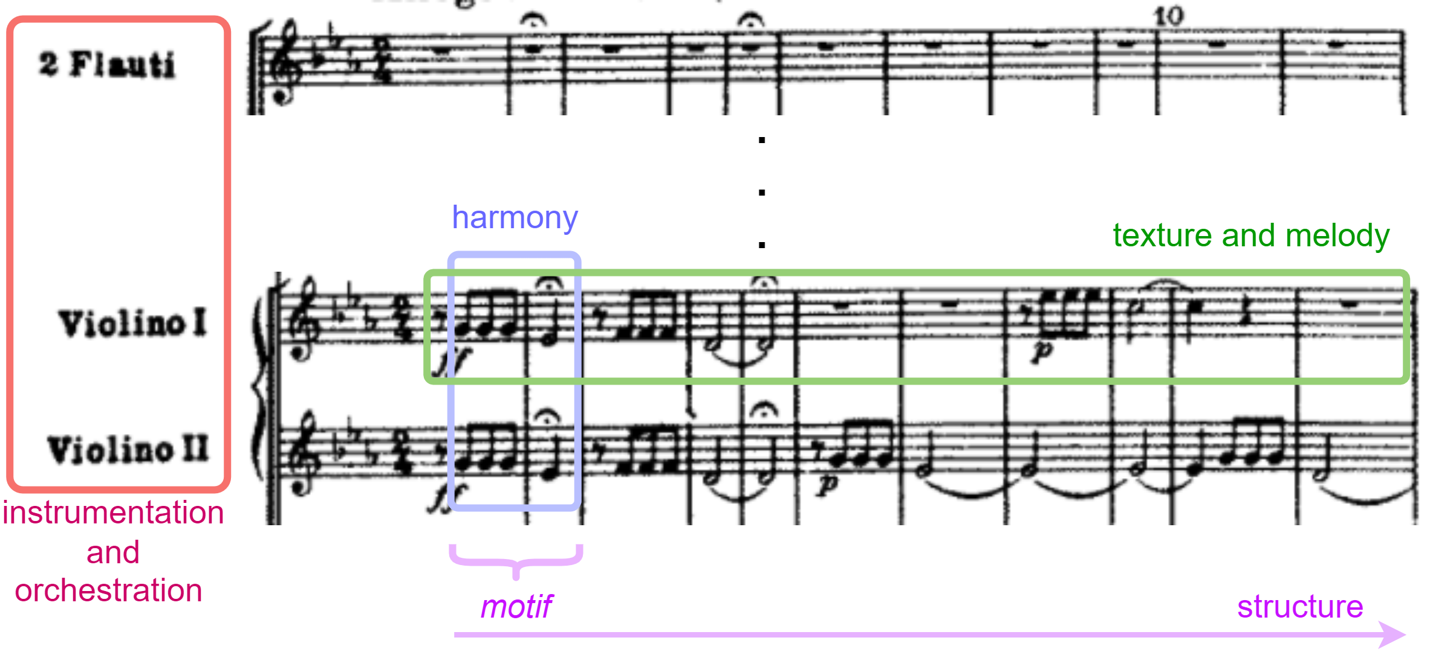
Western classical music
9 / 33
Carlos Hernandez-Olivan, Jose R. Beltran

Slide 10
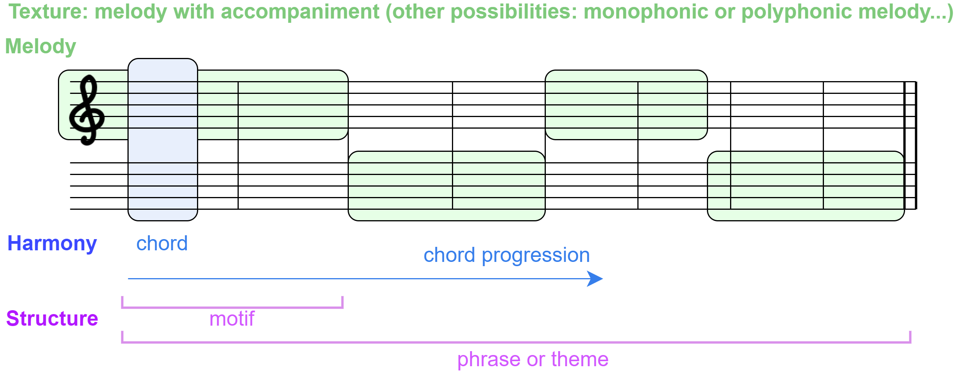
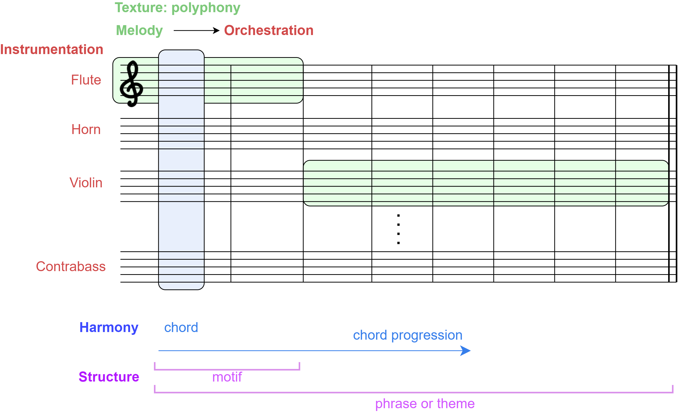
10 / 33
Carlos Hernandez-Olivan, Jose R. Beltran

Slide 11
Music Composition with DL: Motivation
Source: “music generation” search title and abstract (dimensions.ai)
11 / 33
Carlos Hernandez-Olivan, Jose R. Beltran

Slide 12
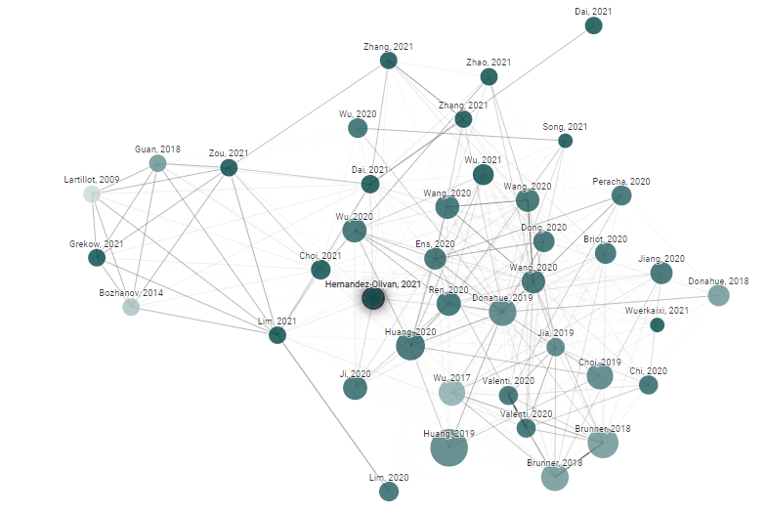
Music Composition with Deep Learning: A Review
Music Composition with Deep Learning: A Review | Connected Papers
12 / 33
Carlos Hernandez-Olivan, Jose R. Beltran

Slide 13
RNN?
Human
modify
RL?
Composition process
(write some chords, melody…)
idea
f
AI
TRAINING
inputs
Model/Algorithm
outputs
inference
“NEW” MUSIC
13 / 33
Carlos Hernandez-Olivan, Jose R. Beltran

Slide 14
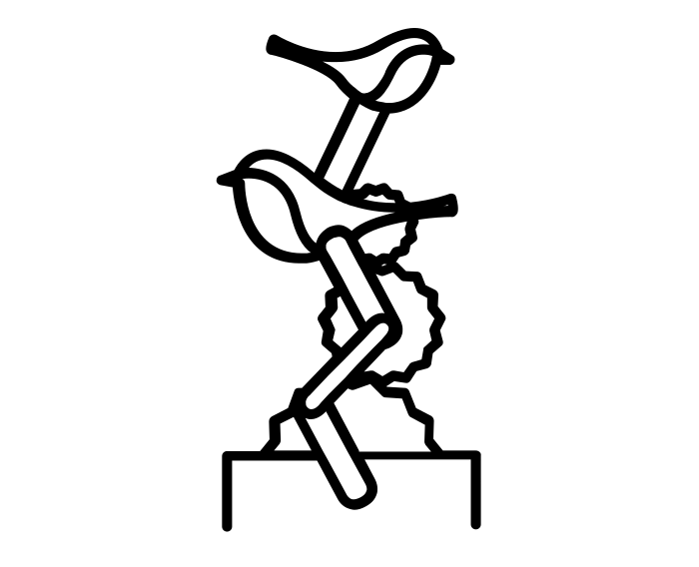
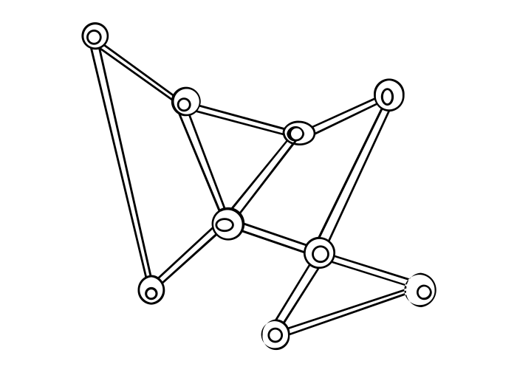
The beginnings: Algorithmic Music
[Nierhaus, 2009] Algorithmic Composition: paradigms of automated music generation.
Markov chains
Generative grammars
Cellular Automata
Algorithmic Music Models
Chaos Theory
Genetic Algorithms
Transition Networks
14 / 33
Carlos Hernandez-Olivan, Jose R. Beltran

Slide 15
The beginnings: Algorithmic Music
Compositions and Projects
ILLIAC Suite
[Hiller & Isaacson, 1957]
EMI or Emmy [David Cope, 1980s]
Analogiques A and B by Iannis Xenakis
Project1 (PR1) [Koening, 1964]
15 / 33
Carlos Hernandez-Olivan, Jose R. Beltran

Slide 16
First Music composition DL-based models
[Lewis, 1988] Creation by refinement: a creativity paradigm for gradient descent learning networks
Training + Creation phases
[Todd, 1988] A Sequential Network Design for Musical Applications.
[Todd, 1989] A connectionist approach to algorithmic composition.
Sequential network
Use memory (notes already produced) by feedback connections
[Mozer, 1994] Neural network composition by prediction: Exploring the benefits of psychophysical constraints and multiscale processing.
CONCERT Network [Elman, 1990]
Continues a sequence of notes
Output is the probability dist. over the candidates
16 / 33
Carlos Hernandez-Olivan, Jose R. Beltran

Slide 17
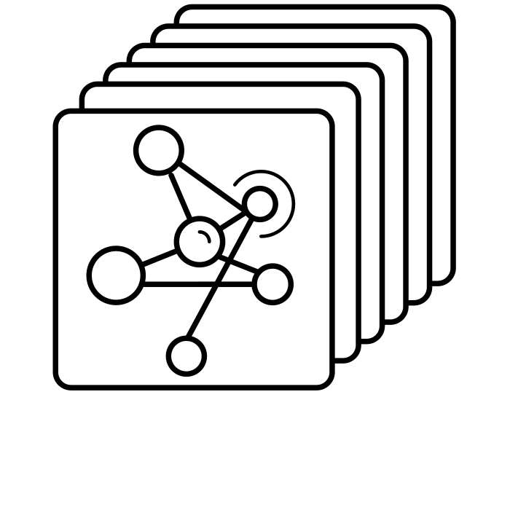
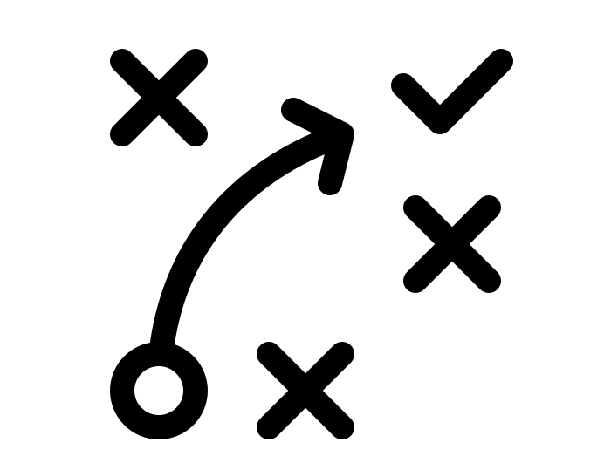
Music composition with DL: Dimensions
[Briot et al., 2019] Deep Learning Techniques for Music Generation – A Survey
REPRESENTATION
NN ARCHITECTURE
OBJECTIVE
Inputs Nature
Output
Texture and Form
CHALLENGES
STRATEGY
Future Directions
How Outputs are generated
17 / 33
Carlos Hernandez-Olivan, Jose R. Beltran

Slide 18
Input Representation
Input Nature: Representation
SYMBOLIC
AUDIO
Discrete events
Signal
Spectrograms
Signals
MIDI
Spectrograms
MusicXML
Audio samples
ABC notation
…
…
18 / 33
Carlos Hernandez-Olivan, Jose R. Beltran

Slide 19
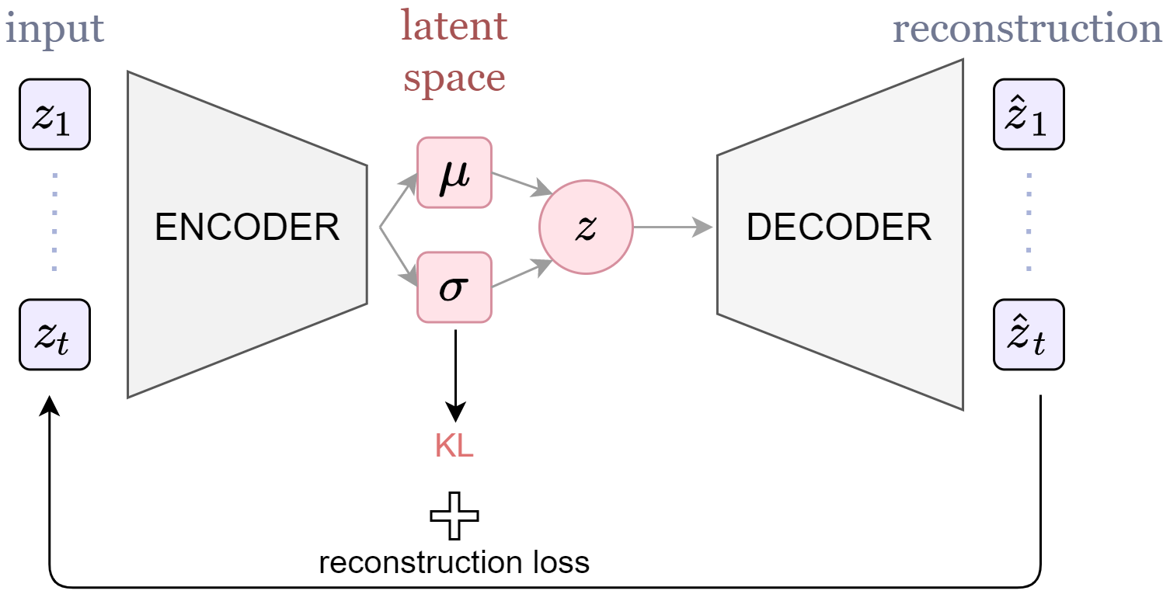
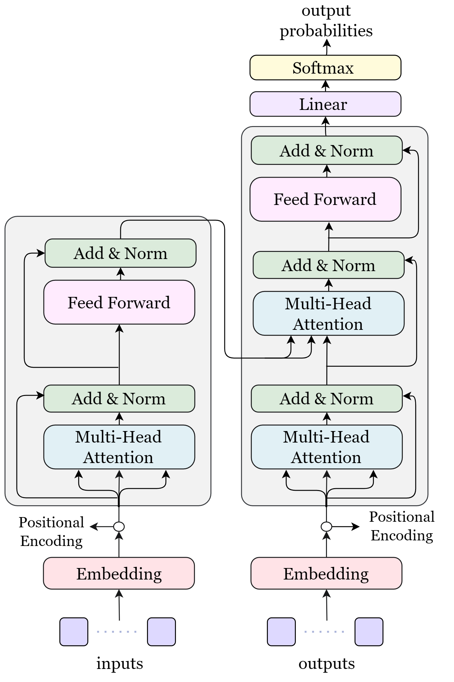
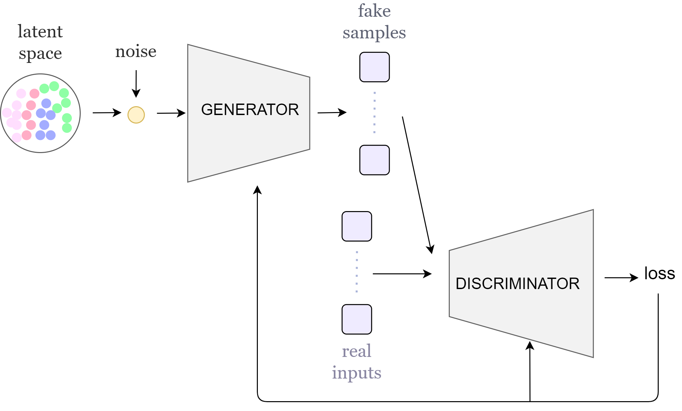
NN Architectures
Generative Models
Sequence Models
VAEs
Recurrent Neural Networks (RNNs)
Transformers
GANs
19 / 33
Carlos Hernandez-Olivan, Jose R. Beltran

Slide 20
Music composition DL
Objective: Texture and Form
MELODY
HARMONIZATION
MULTI-INSTRUMENT
Monophonic
Melody
Ensemble
Orchestra
Polyphonic
Harmony
Texture
Signals
…
Melody +
Accompaniment
…
20 / 33
Carlos Hernandez-Olivan, Jose R. Beltran

Slide 21
Music composition DL: Melody Generation
Monophonic vs Polyphonic melody
[Eck and Schmidhuber, 2012] A First Look at Music Composition using LSTM Recurrent Neural Networks.
Learning Chords
12-bar blues genre
Learning Melody and Chords
21 / 33
Carlos Hernandez-Olivan, Jose R. Beltran

Slide 22
Music composition DL: Melody Generation
[Hadjeres et al., 2017] DeepBach: a Steerable Model for Bach Chorales Generation
Bach Chorales generation (4 voices) with RNNs + Gibbs sampling (MCMC)
[Huang et al., 2018] Music Transformer: Generating Music with Long-Term Structure
Piano pieces trained with MAESTRO dataset
Structure Awareness
[Lattner et al., 2016] Imposing higher-level Structure in Polyphonic Music Generation using Convolutional Restricted Boltzmann Machines and Constraints
22 / 33
Carlos Hernandez-Olivan, Jose R. Beltran

Slide 23
Music composition DL: Multi-Instrument
[Dong et al., 2017] MuseGAN: Multi-track Sequential Generative Adversarial Networks for Symbolic Music Generation and Accompaniment
[Roberts et al., 2018] A Hierarchical Latent Vector Model for Learning Long-Term Structure in Music – “MusicVAE”
[Ens and Pasquier, 2020] Exploring Conditional Multi-Track Music Generation with the Transformer
More: LakhNES…
23 / 33
Carlos Hernandez-Olivan, Jose R. Beltran

Slide 24
Evaluation
SUBJECTIVE
OBJECTIVE
Surveys: User’s opinions
Feature Extraction
Spectrograms
Turing test
Signals
Feature Comparison
AI
vs
Human
Ideally: A combination of both
24 / 33
Carlos Hernandez-Olivan, Jose R. Beltran

Slide 25
Evaluation: Subjective
[Hernandez-Olivan et al., 2022] Subjective Evaluation of Deep Learning Models for Symbolic Music Composition.
Questions for different user levels based on their music knowledge
- beginner
- intermediate
- pro
Cons:
Difficult to reproduce
Lack of automation
25 / 33
Carlos Hernandez-Olivan, Jose R. Beltran

Slide 26
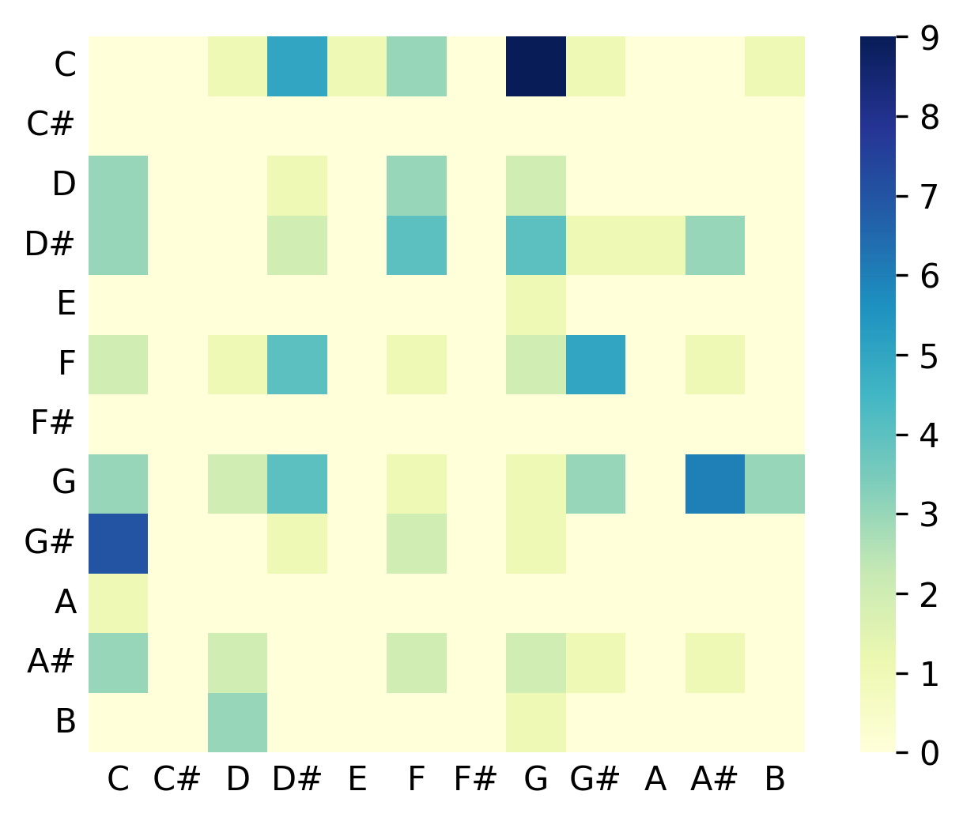
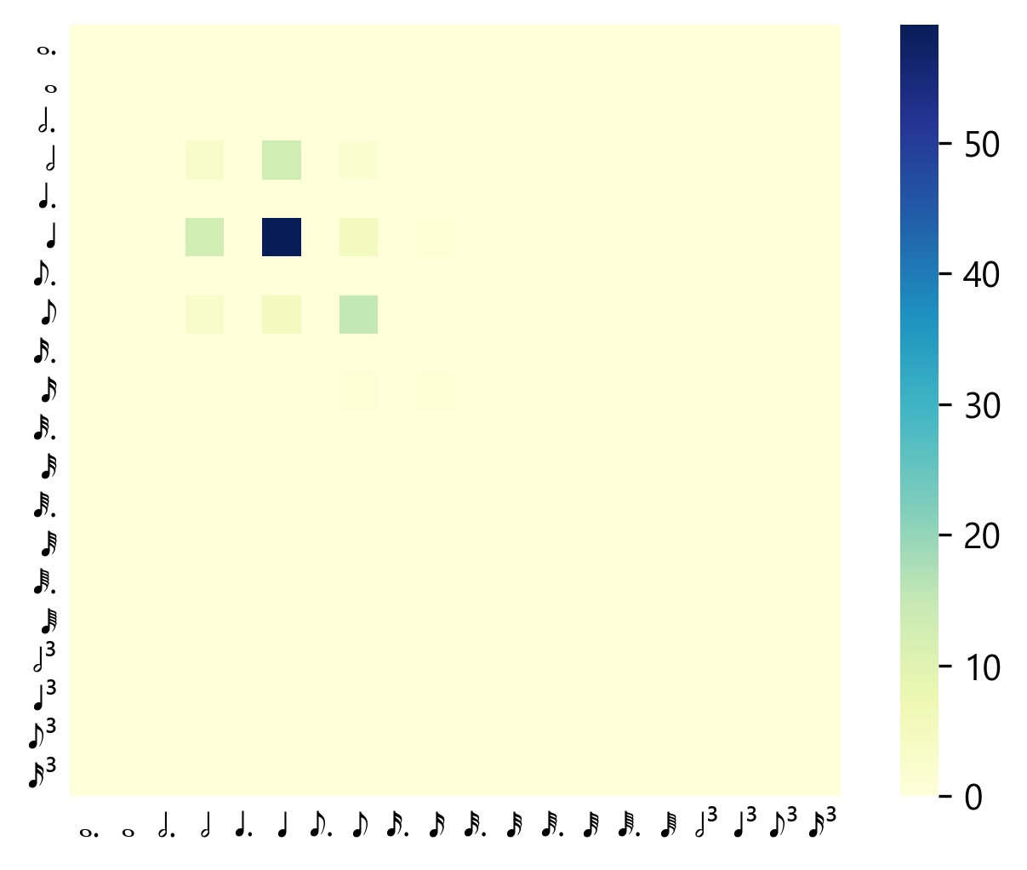
Evaluation: Objective
[Li-Chia Yang and Alexander Lerch, 2019] On the evaluation of generative models in music.
Objective measure from music features at different levels (piece, instrument, bar)
Pitch class transition matrix (PCTM)
Inter and intra (Euclidean) distances between generated and input datasets
PDF from the distance histograms per feature
Note length transition matrix
(NLTM)
KLD and Overlapping Area between the PDFs
26 / 33
Carlos Hernandez-Olivan, Jose R. Beltran

Slide 27
Future Directions
Specialize models to learn music and genres
Objective evaluation
Structure modelling
Deal with longer sequences
Human-Computer interaction
Inpainting…
Generation by conditioning
27 / 33
Carlos Hernandez-Olivan, Jose R. Beltran

Slide 28
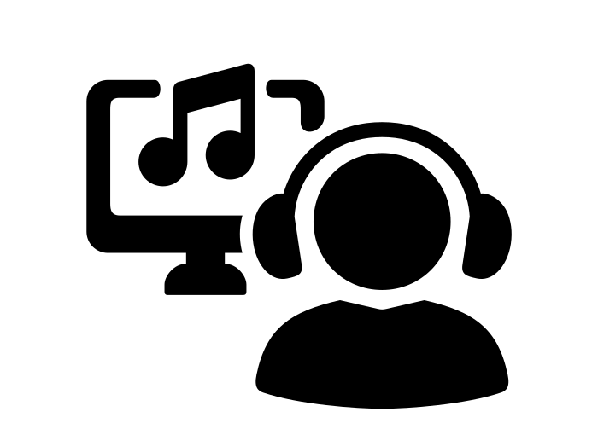
Future Directions
COMPOSITION
INSTRUMENTATION
PERFORMANCE
Composer
Arranger
Director / Producer
“compose something epic”
“add some pizzicato strings”
“more legato in this section”
Symbolic Music Generation with Performance attributes + Synthesis / Audio Music Generation
OpenAI DALLE for music? …
28 / 33
Carlos Hernandez-Olivan, Jose R. Beltran

Slide 29
Recap: Open Questions
Are the current DL models capable of generating music with a certain level of creativity?
What is the best NN architecture to perform music composition with DL?
Could end-to-end methods generate entire structured music pieces?
Are the composed pieces with DL just an imitation of the inputs or can NNs generate new music in styles that are not present in the training data?
29 / 33
Carlos Hernandez-Olivan, Jose R. Beltran

Slide 30
Recap: Open Questions
Should NNs compose music by following the same logic and process as humans do?
How much data do DL models for music generation need?
Are current evaluation methods good enough to compare and measure the creativity of the composed music?
Are we (researchers, developers…) designing DL models according to the music basic principles, or are we just taking models from other fields to do the music composition task?
30 / 33
Carlos Hernandez-Olivan, Jose R. Beltran

Slide 31
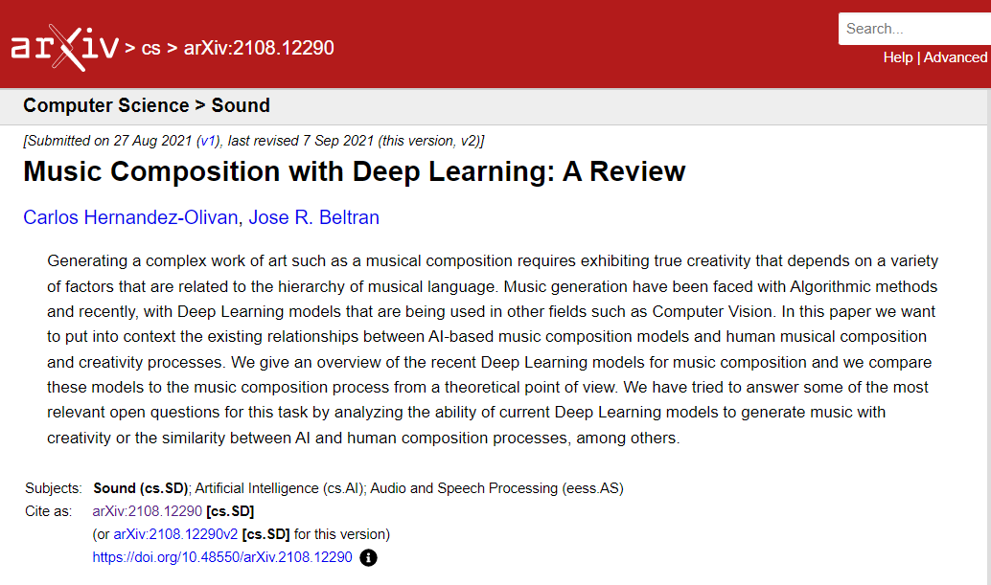
Survey Paper
Accepted as a book chapter in “Advances in Speech and Music Technology: Computational Aspects and Applications” of Springer book series “Signal and Communication Technology”.
https://hacker-news.news/post/28353358
https://github.com/carlosholivan/DeepLearningMusicGeneration
https://arxiv.org/abs/2108.12290
31 / 33
Carlos Hernandez-Olivan, Jose R. Beltran

Slide 32
Acknowledgements
Spanish Science, Innovation and University Ministry Aragonese Government - AffectiveLab
Thanks to Jürgen Schmidhuber for his recommendations
Some images of this presentation have been taken from the Noun Project
32 / 33
Carlos Hernandez-Olivan, Jose R. Beltran

Slide 33
Music Composition with Deep Learning:
A Review
Carlos Hernandez-Olivan*, Jose R. Beltran
April 2022
*carloshero@unizar.es
33 / 33
Carlos Hernandez-Olivan, Jose R. Beltran

